Slide 1
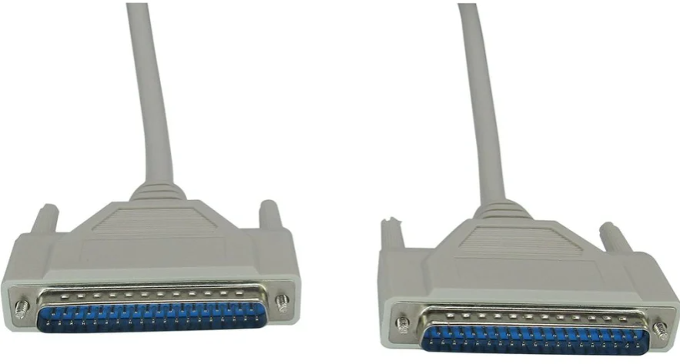
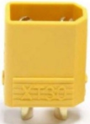
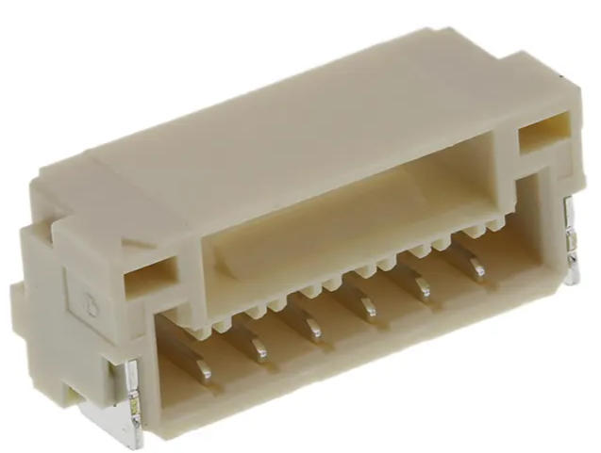
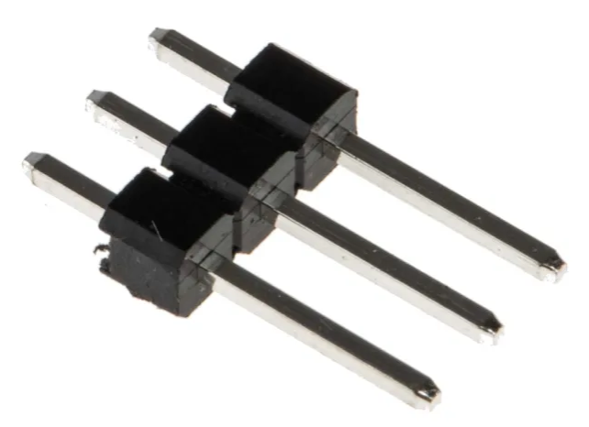
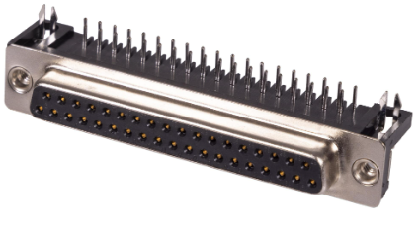
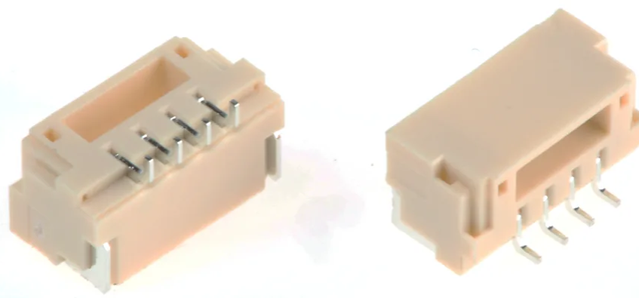

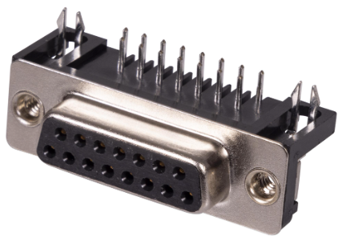
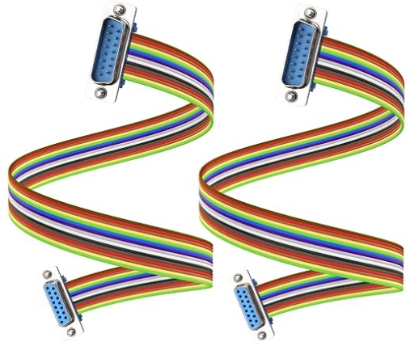
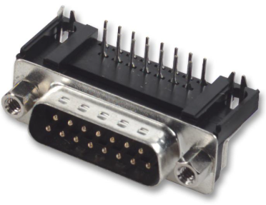
Description | Part Number | Quantity | Supplier URL | ID | Image | Cost (£)
M/M D-Sub Cable | RND 765-00044 | 4 | https://uk.rs-online.com/web/p/serial-cables/2834340 | RND Male D-Sub 37-Pin to Male D-Sub 37-Pin Serial Cable, 1 m, RND Series |  | 34.64
XT30 Male connector |  | 1 | https://www.hobbyrc.co.uk/xt30-male-connectors-2x-male | XT30 Male Connectors (2x Male) |  | Already have
JST GH 6 Way Male | SM06B-GHS-TB(LF)(SN) | 1 | https://uk.rs-online.com/web/p/pcb-headers/7521800 | JST GH Series Right Angle Surface PCB Header, 6 Contact(s), 1.25 mm Pitch |  | 2.39
3 way Male pin header | 251-8092 | 6 | https://uk.rs-online.com/web/p/pcb-headers/2518092 | RS PRO Straight Through Hole Pin Header, 3 Contact(s), 2.54 mm Pitch |  | Already have
37 pin Female D-Sub mount connector | 5504F1-37S-02-03-F1 | 4 | https://cpc.farnell.com/multicomp-pro/5504f1-37s-02-03-f1/socket-d-pcb-r-a-37-way/dp/CN11147 | 37 Pin D-Sub Right Angle PCB Socket with Boardlock |  | 3.20
Servo Connector |  | 6 |  |  |  | Already have
JST GH 4 Way Male | SM04B-GHS-TB(LF)(SN) | 1 | https://uk.rs-online.com/web/p/pcb-headers/7521797 | JST GH Series Right Angle Surface PCB Header, 4 Contact(s), 1.25 mm Pitch |  | 1.87
JST SH 4 Way Mount | SM04B-SRSS-TB(LF)(SN) | 1 | https://cpc.farnell.com/jst-japan-solderless-terminals/sm04b-srss-tb-lf-sn/connector-header-smt-r-a-1mm-4way/dp/CN26550 | Pin Header, Right Angle, Wire-to-Board, 1 mm, 1 Rows, 4 Contacts, Surface Mount Right Angle |  | 0.26
15 pin female D-Sub mount | 5504F1-15S-02-03-F1 | 1 | https://cpc.farnell.com/multicomp-pro/5504f1-15s-02-03-f1/socket-d-pcb-r-a-15-way/dp/CN11145 | 15 Pin D-Sub Right Angle PCB Socket with Boardlock |  | 0.52
M/F 15 pin D-Sub cable |  | 2 | https://www.amazon.co.uk/JSADZKJ-Extension-Connecter-Straight-Computers/dp/B0D95BSP16/ref=sr_1_1_sspa | Serial (15-Pin) DB15 RS 232 Converter Cable |  | 11.99
Custom made JST GH 4 and 6 way & SH 4 way extension cables. |  | 1 of each
15 pin male D-Sub mount | 8LCM015P-301B-XX | 1 | https://cpc.farnell.com/multicomp-pro/8lcm015p-301b-xx/plug-d-pcb-r-a-15way/dp/CN15215 | 15 Pin D-Sub Right Angle PCB Plug |  | 6.48

